Slide 1

Title: Investigate Image Reconstruction by Using Classifiers
Software Engineering Project
Presented by:
Guided by:
Abdul Wahab - 1447523
Romana Rashid - 1428733
Nishat Tasnim Nabila - 1502853
Prof. Damir Dobric

Slide 2
Table of Content:
Introduction
Objective
Introduction to HTM and KNN classifier
HTM classifier’s native implementation
KNN classifier’s native implementation
HTM and KNN classifier’s integration with Neocortex Api & Unit testing
HTM and KNN classifiers on SP generated SDRs & Unit testing
Conclusions

Slide 3
Introduction
In this project, an experiment which is performed to makes us indulge with the knowledge of Sparse Distributed Representations (SDRs),classifiers and an integral component in the neocortexapi. Reconstructing or approximating an image from incomplete, noisy, or partial data is the basic challenge in image reconstruction in computer vision, machine learning, and artificial intelligence. By converting input images into sparse binary encodings and passing them through a Spatial Pooler, the system simulates how the neocortex processes information. Both classifiers are trained on SDRs and connected to corresponding reconstruction modules that attempt to rebuild the original image content. Image reconstruction has use in many important areas. Image reconstruction improves object identification, feature classification, and pattern recognition under demanding situation. This work offers a computationally efficient and interpreted method applicable to many fields by solving the difficulties related to conventional deep learning models. The results of this study could provide fresh avenues for creating strong, scalable image reconstruction methods catered to practical applications.

Slide 4
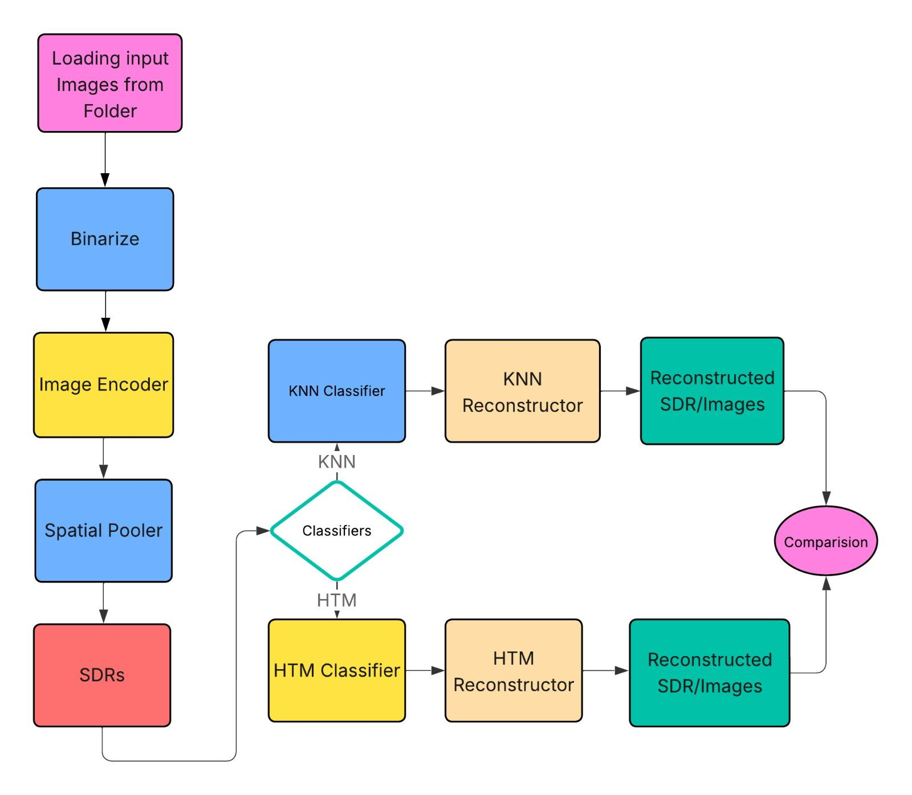
Objectives
To implement an image processing pipeline that converts input images into binary format for efficient sparse encoding.
To generate Sparse Distributed Representations (SDRs) using an image encoder followed by a Spatial Pooler inspired by the HTM framework.
To apply and train two classifiers — HTM and k-NN — on the SDR dataset for predictive modeling.
To reconstruct images from the classifier outputs using dedicated HTM and k-NN reconstructor modules.
To perform a comparative evaluation of HTM and k-NN reconstruction accuracy and quality.
To analyze which classifier better preserves the original image information in the reconstruction process.

Slide 5
Introduction to HTM Classifier
A machine learning model with biological inspiration, the HTM (Hierarchical Temporal Memory) classifier is based on the structure and function of the human brain's neocortex. It is a component of the HTM framework, which Numenta initially created. its key strength lies in learning temporal patterns and making predictions over time.
The HTM Classifier is used to:
Interpret patterns learned by the HTM Temporal Memory.
Map Sparse Distributed Representations (SDRs) to class labels or numeric values.
Make real-time predictions in streaming data environments.

Slide 6
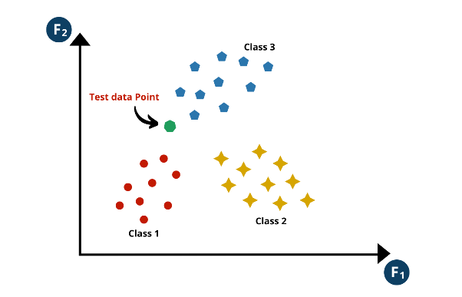
Introduction to KNN Classifier
KNN classifier operates by classifying the data point based on the majority class of its nearest neighbors in the feature space.
In essence, the KNN classifier assigns the class label of the majority of its k nearest neighbors to the new data point, making it a non-parametric and instance-based learning method.
New datapoint to be classified is introduced into the KNN classifier

Slide 7
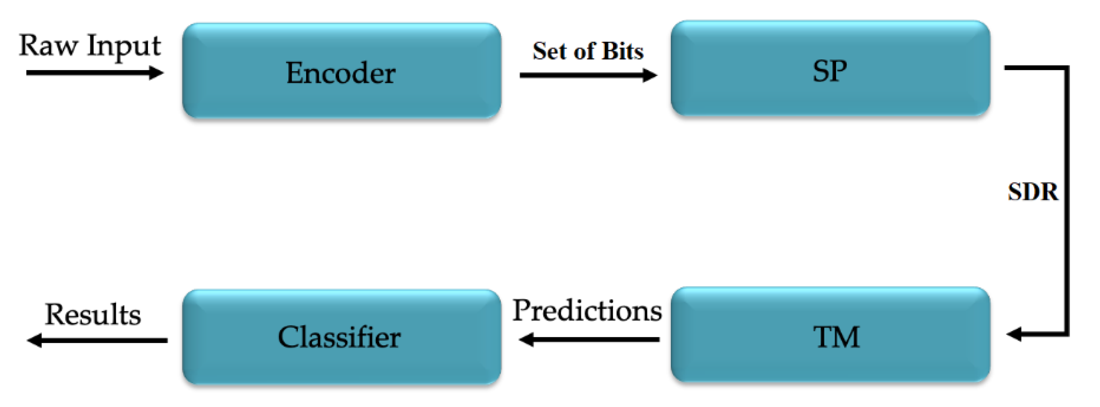
HTM Classifier Working Principle
The HTM Classifier is part of the HTM system, and it works together with components like the Encoder, Spatial Pooler, and Temporal Memory. It is designed to map the internal state of the HTM network (typically the active cells in Temporal Memory) to a predicted class label or value.
Input Data → Encoder: Converts data into a binary Sparse Distributed Representation (SDR).
SDR → Spatial Pooler: Learns stable, sparse representations of input.
Spatial Output → Temporal Memory (TM): Learns sequences of patterns over time.
Active Cells → HTM Classifier:
• It observes which SDRs are associated with which outputs.
• It predicts the most likely class/number based on the current active SDR and learned history.
Fig. HTM Workflow Diagram

Slide 8
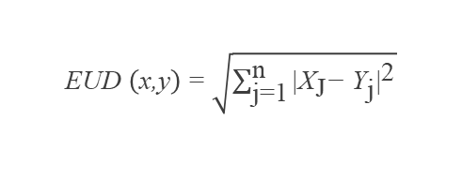
Important Parameters in KNN Classifier
The working of a KNN classifier depends on multiple parameters as explained below:
Value of K: The choice of K in the K-nearest neighbors (KNN) classifier influences the prediction by considering a specified number of neighboring data points. Odd values are often favored to prevent tie situations during voting, ensuring unambiguous class assignments.
Distance Metrics: The distance metric in K-nearest neighbors (KNN) classification defines how distances between the two data points are measured, We've employed the Euclidean distance method, one of several available, to measure distances between data points, which is given by:
Voting Scheme: In the k-nearest neighbors (kNN) algorithm, the voting scheme involves assigning a class label to a data point based on a majority or weighted vote from its k nearest neighbors.
Cross-Validation Parameters: Cross-validation parameters, including the number of folds and scoring metric choice, are crucial for evaluating the KNN classifier's performance and preventing overfitting.
EUD $\left(\text{x}\text{,}\text{y}\right)\text{ = }\sqrt{\sum_{\text{j}\text{=1}}^{\text{n}}{{\text{|}{\text{X}}_{\text{J}}\text{−} {\text{Y}}_{\text{j}}\text{|}}^{\text{2}}}}$

Slide 9
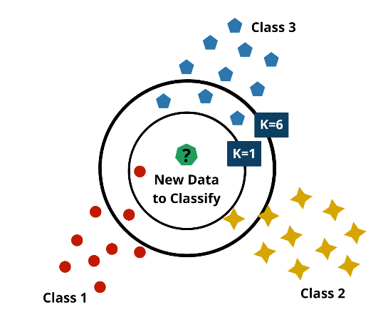
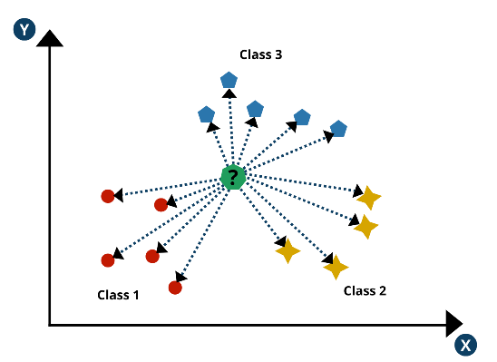
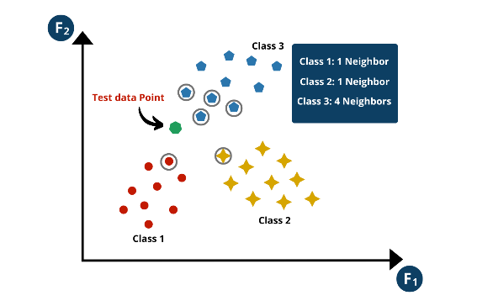
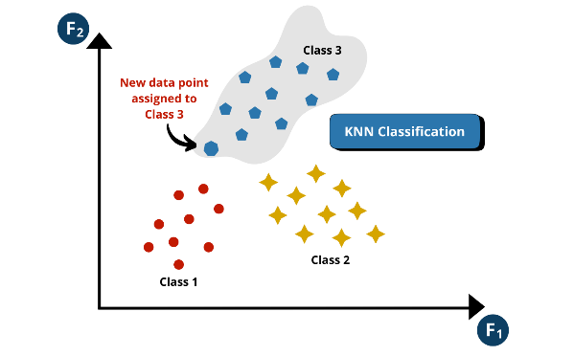
KNN Classifier Working Principle
Step 1: Selecting the value of K for KNN
Step 2: Distance calculation for each data point
Impact of value k on KNN classification
Calculated distance for each data point
Step 3: Voting and Prediction for new data point
Step 4: Predicting the Class of the new data point
Voting based on the distance calculated
Assignment of class after majority voting

Slide 10
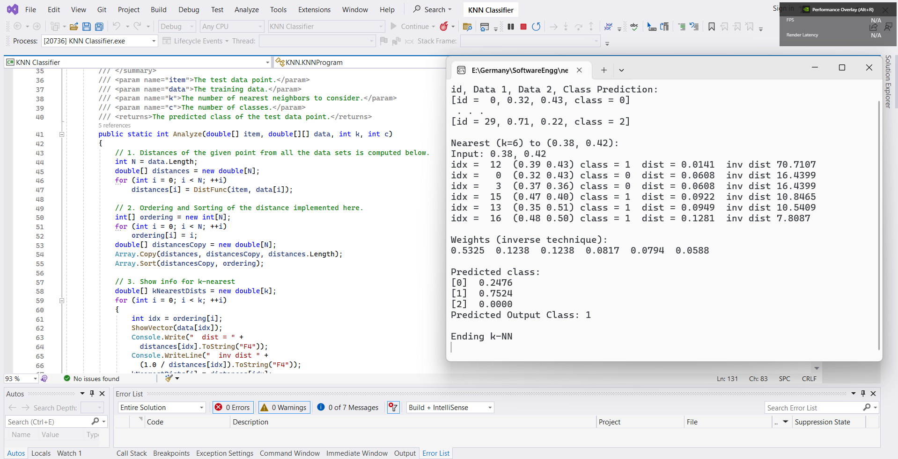
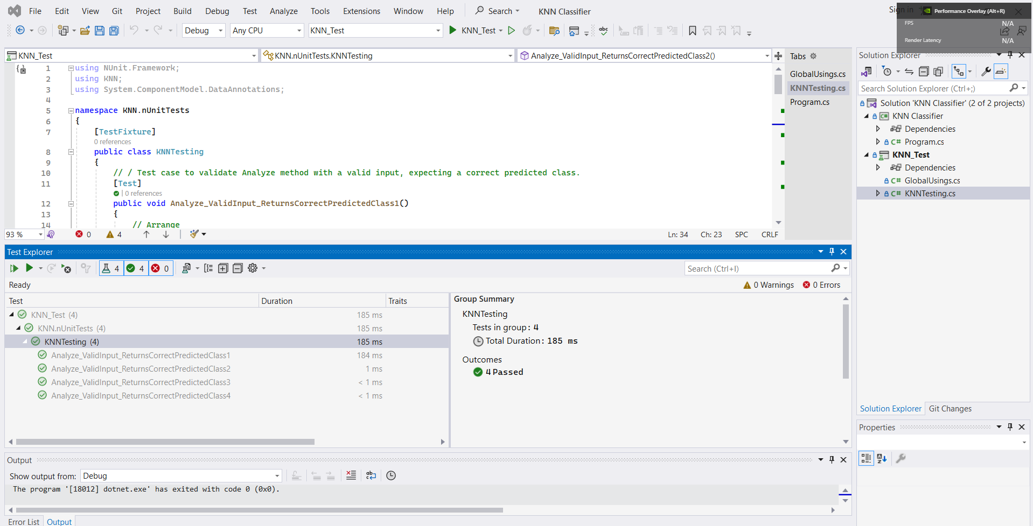
Results and Unit Test for Native HTM and KNN Classifier
The model takes two dimensional data points with three different classes and classifies the new data point using the KNN classifier.
Native HTM & KNN Classifier Output
Unit Tests for Native HTM & KNN Classifier

Slide 11
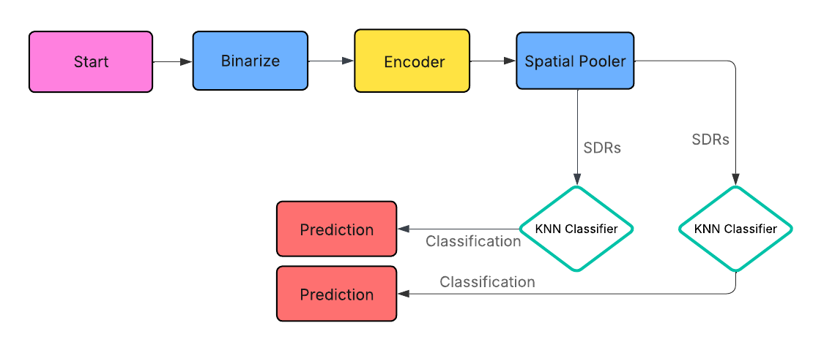
Integration of HTM & KNN with Neocortex API
A comprehensive framework for sequence learning and classification incorporates input images, binarization, encoder, Spatial Pooler, Hierarchical Temporal Memory (HTM) , and K-nearest neighbor (KNN) classifier.
HTM and KNN classifiers integration with Neocortex API

Slide 12
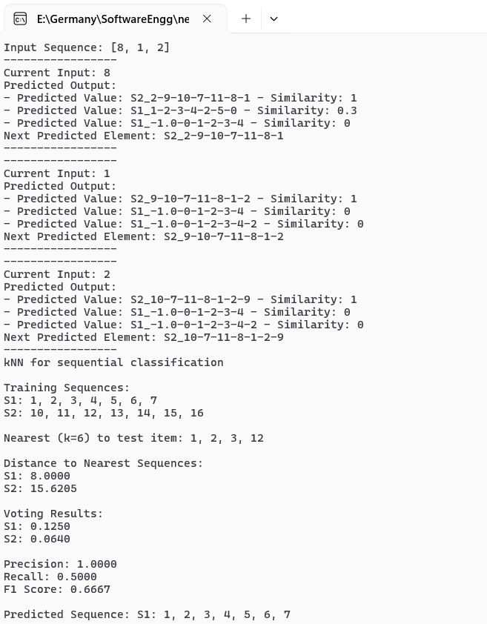
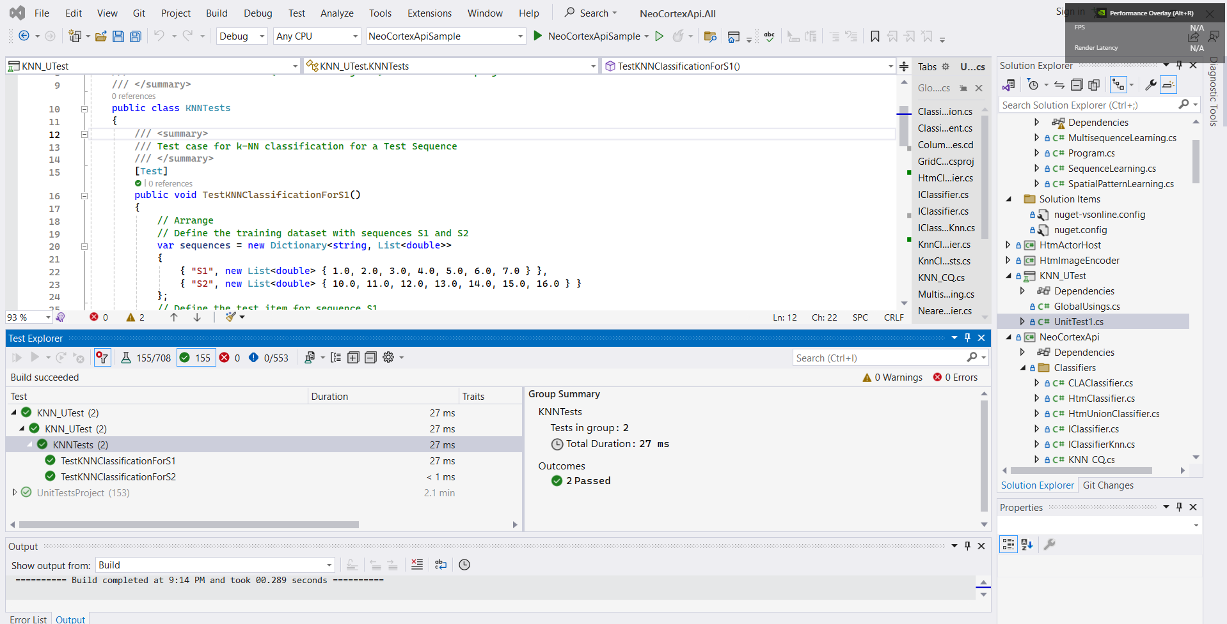
Results and Unit Test for HTM & KNN integrated with Neocortex API
KNN classifier integration with Neocortex API
Unit tests for HTM & KNN classifier with Neocortex API

Slide 13
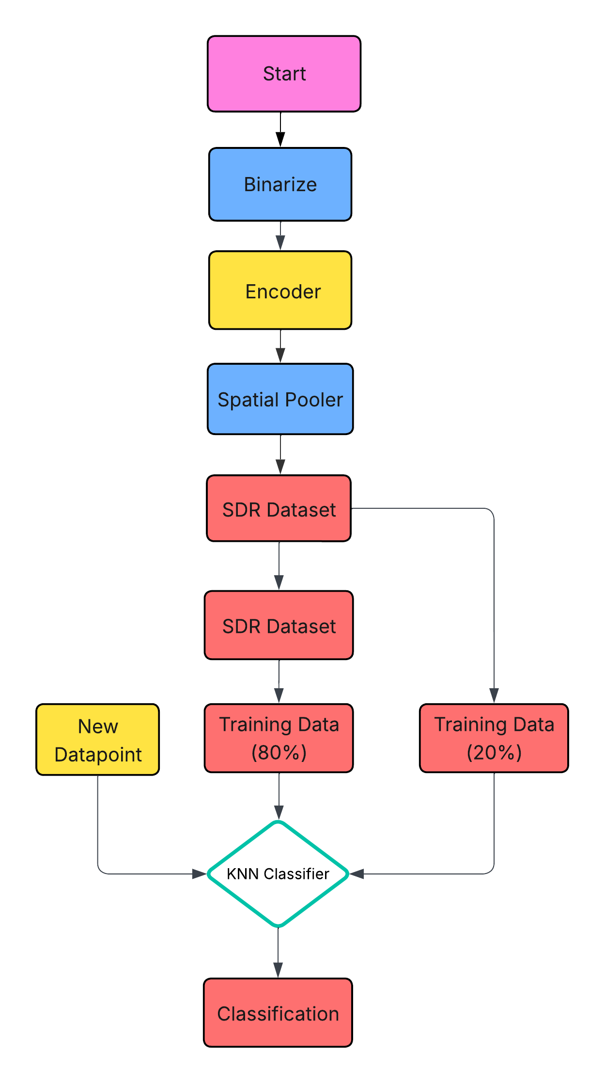
KNN classifier with Spatial Pooler generated SDRs
From the Spatial Pooler Learning Experiment, the dataset for SDRs is obtained and split into 80% and 20% for training and testing respectively.
5-fold cross validation is used to train a KNN classifier using the training data and evaluates its accuracy on the testing data to evaluate how it behaves on different folds of training and testing datasets.
The results obtained from the 5-fold cross-validation revealed a classification accuracy of 90%. This high accuracy level indicates the model's ability to make accurate predictions on unseen data instances across the different folds of the cross-validation process.
The KNN classifier, after being trained on 80% of the dataset, is able to accurately predict the output of a new data point with 100% accuracy when value of k is 3 and wit 85% accuracy when the value of k is set to 6.
Process diagram for KNN classification with SP generated SDRs

Slide 14

HTM classifier with Spatial Pooler generated SDRs
From the HTM-based classification experiment, a dataset of Sparse Distributed Representations (SDRs) was generated using the Spatial Pooler, capturing the essential patterns of input data. This SDR dataset was divided into 80% for training and 20% for testing.
From the HTM-based classification experiment, a dataset of Sparse Distributed Representations (SDRs) was generated using the Spatial Pooler, capturing the essential patterns of input data. This SDR dataset was divided into 80% for training and 20% for testing.
During evaluation, the classifier was tested on the 20% held-out test set. The classifier used its learned temporal memory to match the new input SDRs with known patterns and generate predictions based on past sequence context.
The evaluation revealed that the HTM Classifier achieved a prediction accuracy of approximately 89%, showcasing its strong capability to generalize across unseen data. This level of accuracy reflects the classifier’s robustness in handling temporal patterns and sparse inputs, even with relatively limited training data.
Overall, the experiment highlights the HTM Classifier’s strength in temporal pattern recognition, making it highly suitable for applications involving streaming or time-series data.
Process diagram for HTM classification with SP generated SDRs

Slide 15
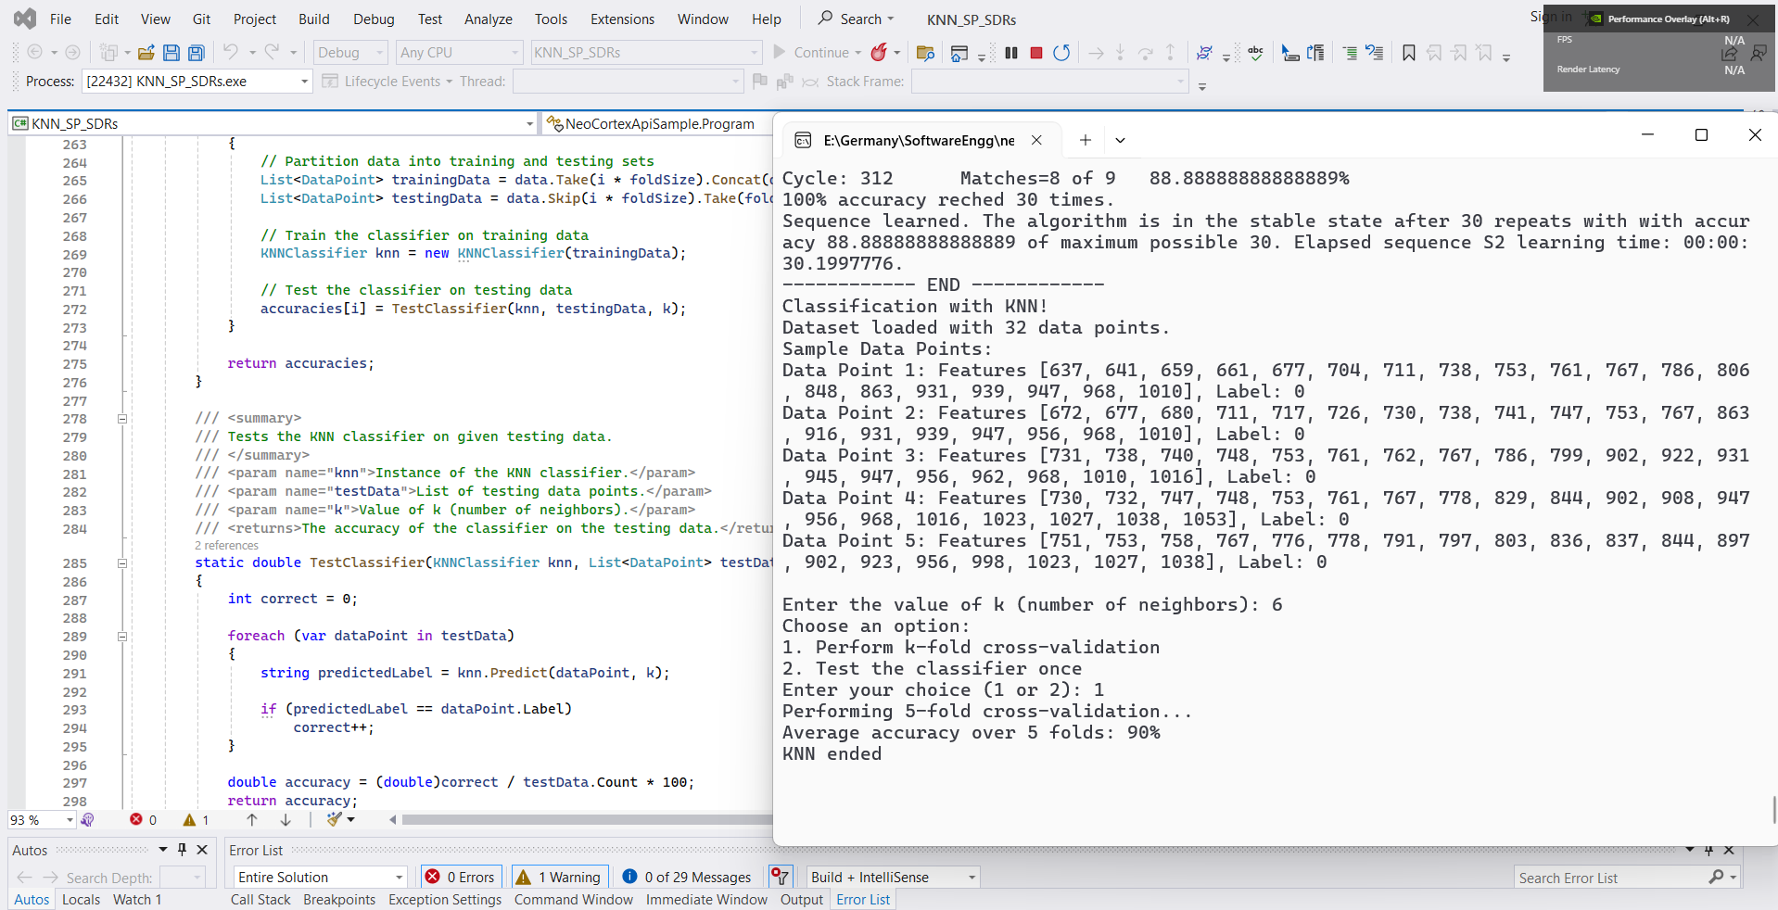
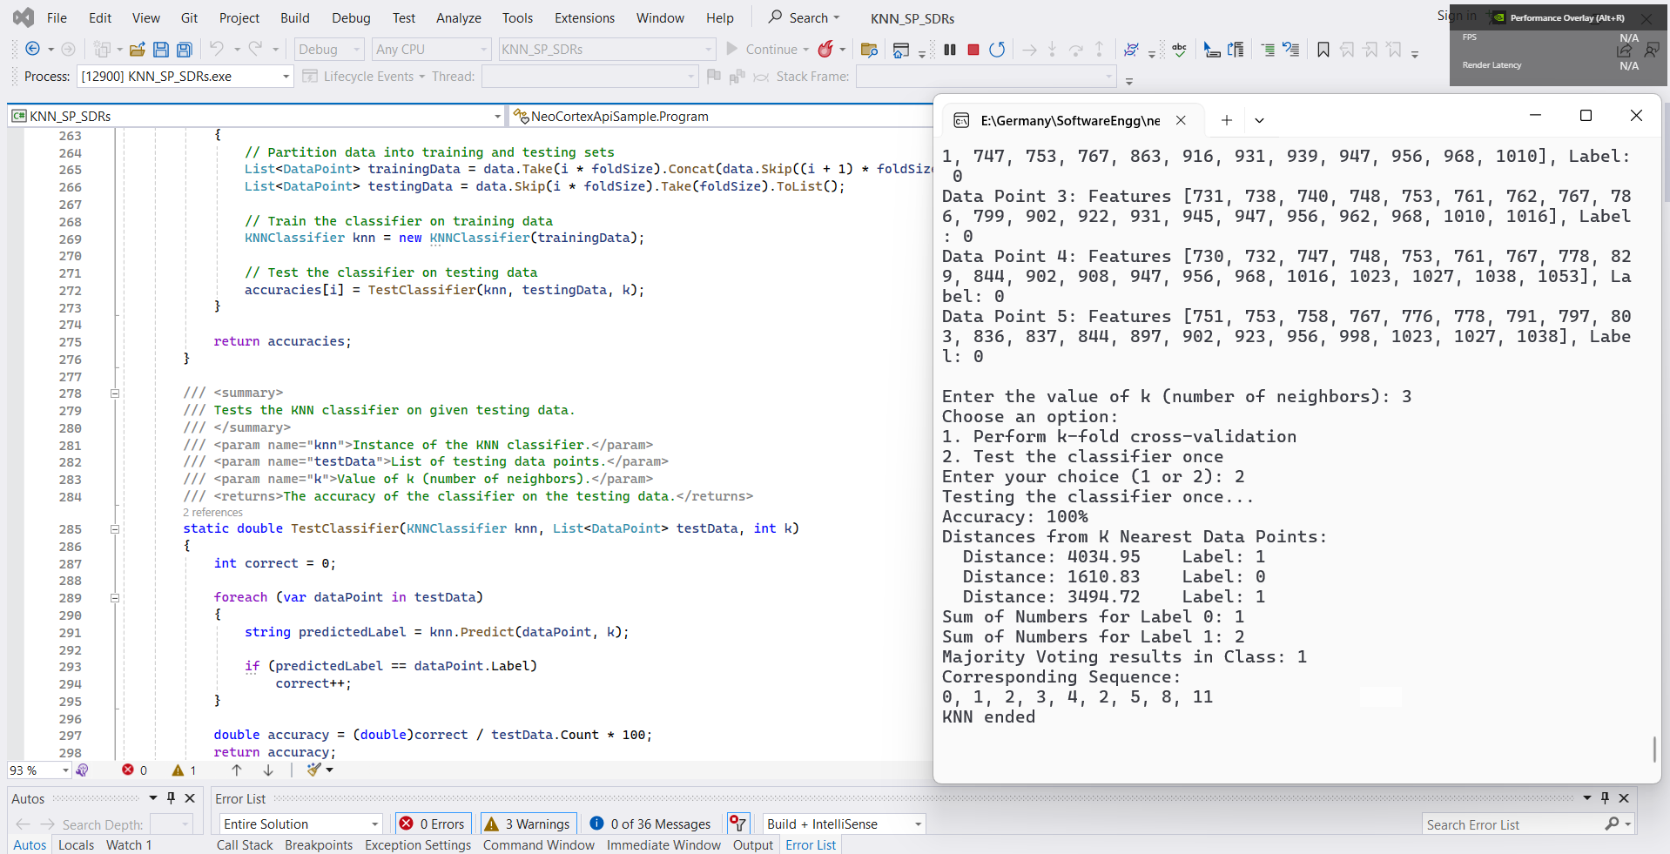
HTM & KNN Classifier with Spatial Pooler generated SDRs
Results for 5-fold cross validation
KNN classifier prediction when SP generated SDRs are fed

Slide 16
KNN Classifier with Spatial Pooler generated SDRs
The accuracy of the KNN model is closely tied to the choice of the k parameter, and finding the optimal value of k is an important step in the model development process.
The optimal value of k is typically determined through a process of cross-validation or other model selection technique-s, as it can vary depending on the specific dataset and problem at hand.
The figure shows the trade off and impact evaluation for values of k on KNN classifier results.
Value of k (integer) | Accuracy of prediction in percentage (%)
1 | 100
2 | 100
3 | 100
4 | 100
5 | 89
6 | 85
Impact of k on the accuracy of the model

Slide 17
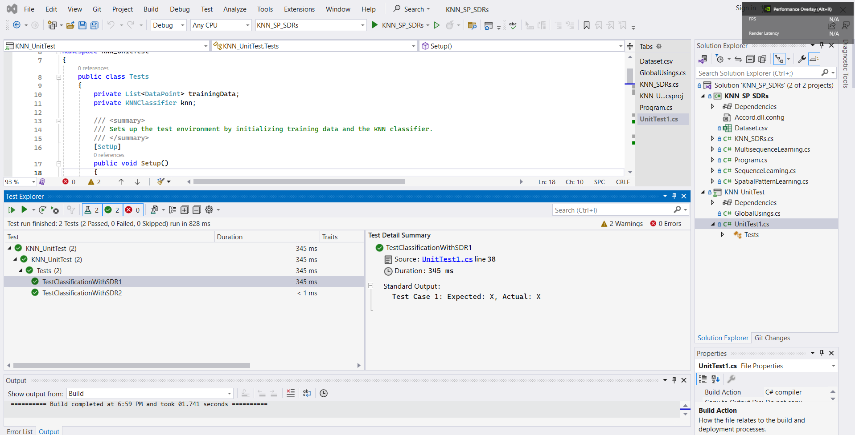
KNN Classifier with Spatial Pooler generated SDRs - Unit Testing
Unit tests for KNN classifier on SP generated SRDs

Slide 18
Conclusions
The research introduces K-Nearest Neighbors (KNN) classification within the Neocortex API framework, inspired by neocortical information processing.
By integrating spatial pooling and hierarchical temporal memory (HTM), the method enhances the classification of sequential data streams.
Through rigorous testing and integration with the Neocortex API, the study consistently demonstrates the model's effectiveness, achieving a commendable 90% accuracy rate across varied scenarios.
These findings underscore the potential of neuromorphic-inspired frameworks in advancing sequential data analysis.
Moving forward, optimizing performance and exploring broader applications remain promising areas for future research, reflecting the ongoing convergence of traditional machine learning and biologically inspired computational models.

Slide 19

Thank You

